Slide 1

Sam Hollander, Ilya Smushkin, Mariano Crivello, Douglas Lu

Slide 2
THE AGENDA
World Bank Background
Query 1
Query 2
Query 3
Conclusion and Analysis

Slide 3

What is World Bank?
Quick Facts
Formation: July 1945 (72 Years Ago)
Goal: End extreme poverty and promote shared prosperity
Headquarters: Washington, D.C.
President: Jim Yong Kim
Membership: 189 Countries
Type: International Financial Institution

Slide 4
What is World Bank?
History
Has helped more than 100 developing countries by offering loans and advice
Works with government, private, civil society, and regional development banks
Plays leading role in climate change, pandemics, and forced migration
As of 2015, World Bank has provided more than $60B in loans across 302 commitments
Provides global development data on 185+ countries across 20 major indicators including health, infrastructure, economy

Slide 5
Our Focus
CO2 Emissions per Capita versus GDP per Capita
Business Start Time in the Past 5 Years
Net Foreign Direct Investment versus Sanitation and Education

Slide 6
THE AGENDA
World Bank Background
Query 1
Query 2
Query 3
Conclusion and Analysis

Slide 7
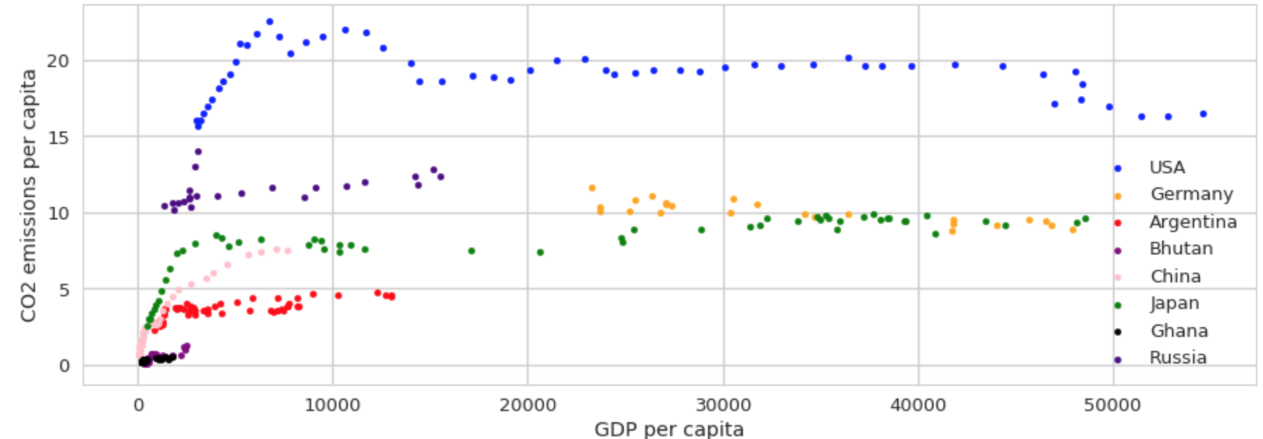
CO2 Emissions per Capita versus GDP per Capita

Slide 8
Key Takeaways
Key Takeaways:
Most developed countries exhibit a strong initial CO2 emissions growth per capita that eventually levels off
As GDP grows, one would assume that CO2 per capita would grow as well, but our data shows that it levels off
Developed countries such as U.S exhibit significantly higher CO2 emissions than undeveloped countries such as Bhutan

Slide 9
THE AGENDA
World Bank Background
Query 1
Query 2
Query 3
Conclusion and Analysis

Slide 10
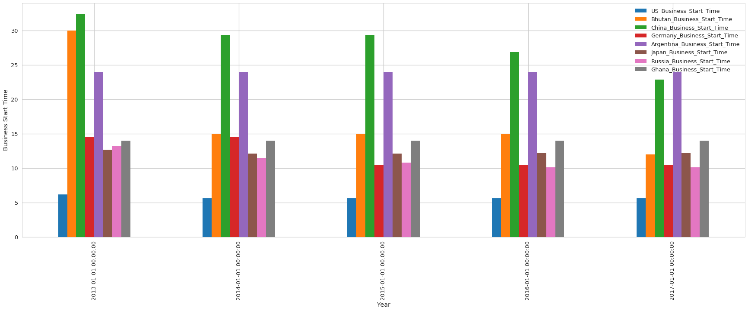
Business Start Time in the Past 5 Years

Slide 11
Key Takeaways
Key Takeaways:
For most countries, business start time improves over time
Business start time in developed countries like China still takes a long time, due to regulation
Less developed countries like Bhutan require less time to start a business, perhaps due to its high economic freedom and ease of doing business

Slide 12
THE AGENDA
World Bank Background
Query 1
Query 2
Query 3
Conclusion and Analysis

Slide 13
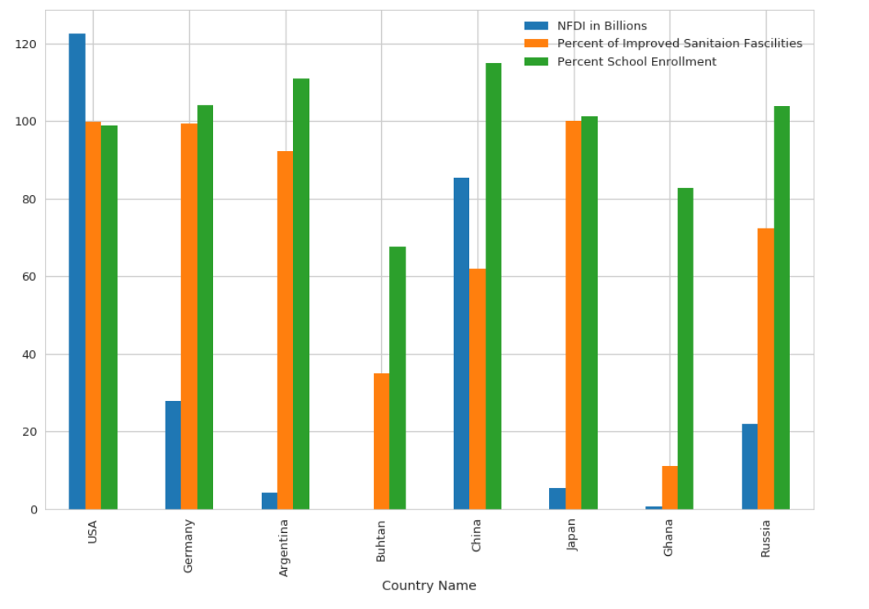
Query 3

Slide 14
Key Takeaways
Key Takeaways:
Across the board, almost all countries value education
Countries prefer to invest in education over sanitation
High NFDI does not guarantee improved sanitation, as countries like Argentina, Japan, and Russia exhibit high sanitation qualities despite low NFDI

Slide 15
THE AGENDA
World Bank Background
Query 1
Query 2
Query 3
Conclusion and Analysis

Slide 16
Conclusion & Takeaways
Takeaways:
Data is difficult to manipulate and open to interpretation
Its important what data you are using, as we learned that manipulating datasets is very important
Key aspect of data analysis is how effective you can clean up the dataset
Combining methods on different layers of data analysis

Slide 17
Q&A

